Slide 1
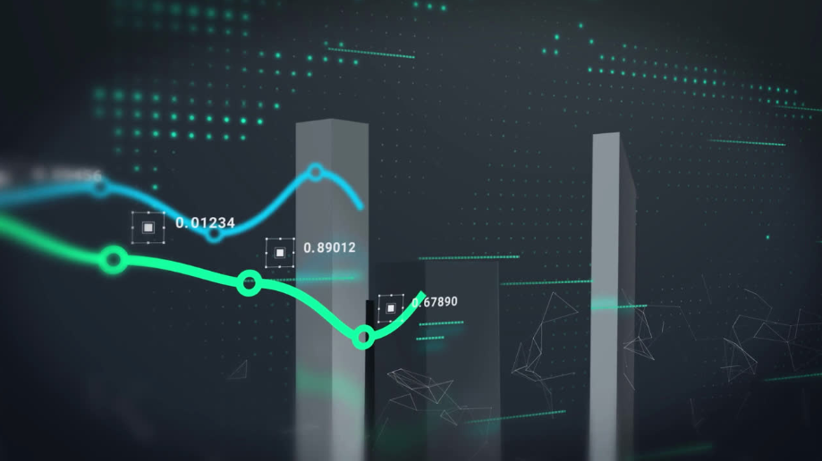

CSD 301 DESCRIPTIVE ANALYTICS PROJECT
CUSTOMER PURCHASE BEHAVIOUR ANALYSIS
ADITYA KUMAR SINGH
12304738

Slide 2
CONTENTS
1. INTRODUCTION
6. FOMO
2. PURPOSE OF STUDY
7. CONCLUSION
3. PROBLEM STATEMENT
4. DATA COLLECTION
5. EDA

Slide 3
INTRODUCTION
This project analyzes online shopping behavior to understand what influences customer decisions. Using survey data and Exploratory Data Analysis (EDA), it focuses on factors like age, income, and platform choice. A key highlight is the impact of emotional triggers, especially FOMO (Fear of Missing Out), on consumer habits. The goal is to provide insights that help businesses better connect with their customers.

Slide 4
PURPOST OF STUDY
In this project, I am going to research Customer Purchase Behavior to identify the factors that affect consumer shopping choices and spending behavior. By analyzing customer shopping habits, preferences, and the effect of promotions, this study will generate useful insights that can assist businesses in enhancing marketing strategies and improving customer satisfaction.

Slide 5
PROBLEM STATEMENT
In the rapid retail environment of today, customer buying behavior must be understood so that businesses can stay competitive and satisfy consumers. Yet, few businesses are able to recognize such factors that guide customer choice as brand affinity, expenditure patterns, promotional influence, and seasonal patterns of buying. Without insights, retailers might end up failing to attract and retain customers, with resulting lower sales and poor satisfaction.

Slide 6
DATA COLLECTION
For the purpose of this Customer Purchase Behavior study, data was collected using a Google Form survey. The survey aimed to obtain thorough information regarding diverse facets of consumer shopping behavior such as preferences, expenditure, brand loyalty, and purchase decision influences.

Slide 7
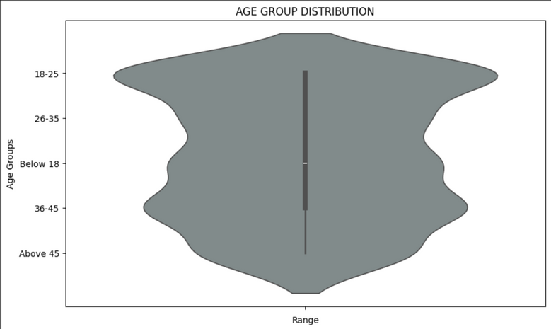
EXPLORATORY DATA ANALYSIS (EDA)
Age Distribution :-
Target audience for online retail marketing is predominantly youth-centric.

Slide 8
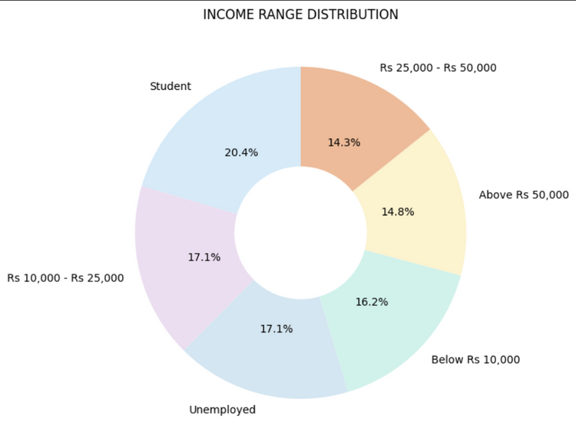
EXPLORATORY DATA ANALYSIS (EDA)
Income Range Distribution :-
Income Range :-
Most respondents had a monthly income of Below Rs. 25,000, primarily due to student demographic.
Very few earned above Rs. 50,000.
Spending Per Purchase :-
Majority spend between Rs. 500 - 1500 on average per purchase.
Smaller groups spend either below Rs. 500 or over Rs. 2000.

Slide 9
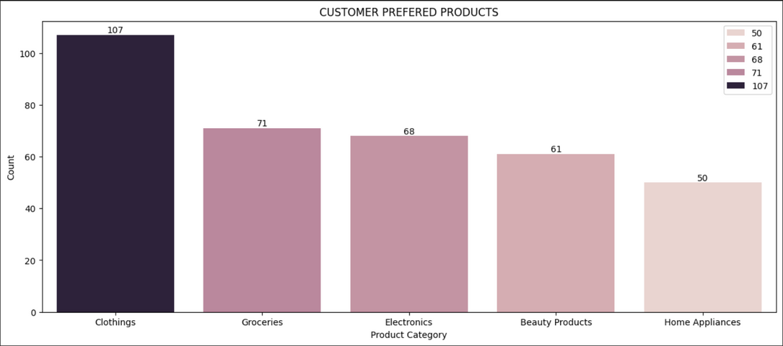
EXPLORATORY DATA ANALYSIS (EDA)
Preferred Categories :-
Top Choices : Clothing, Electronics, Groceries
Others : Footwear, Beauty Products, Books

Slide 10

EXPLORATORY DATA ANALYSIS (EDA)
Purchase Influencers :-
Top drivers : Discounts, Reviews, Brand Image
Secondary drivers : Peer Recommendations, Ads

Slide 11
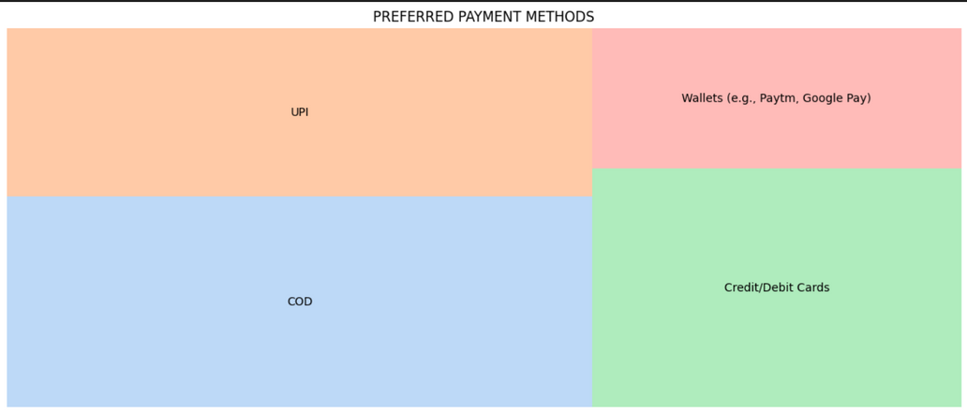
EXPLORATORY DATA ANALYSIS (EDA)
Payment Methods :-
Most used : COD & UPI
Others : Wallets (Paytm, G Pay), Credit/Debit Cards

Slide 12
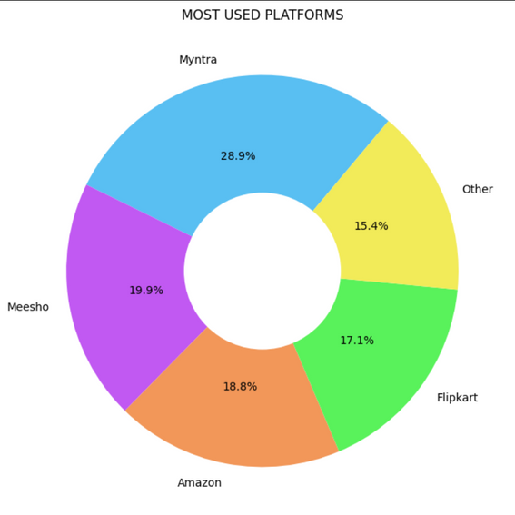
EXPLORATORY DATA ANALYSIS (EDA)
Preferred Platforms :-
Top 3 : Myntra, Meesho, Amazon
Others : Flipkart, Other

Slide 13
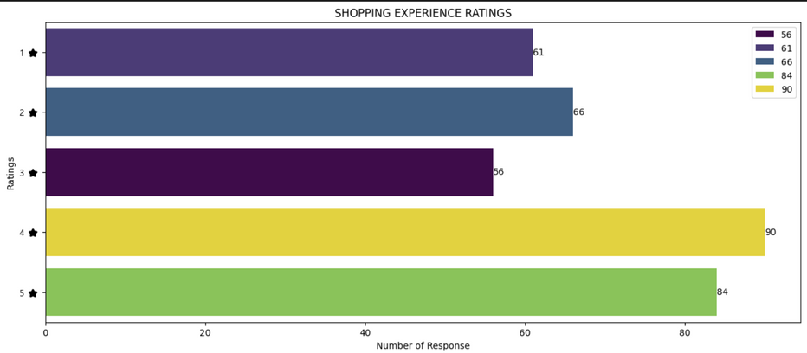
EXPLORATORY DATA ANALYSIS (EDA)
Overall Shopping Experience :-
Rated on a scale of 1 to 5
Most Common Rating : 4
Average Rating : 3

Slide 14
FEAR OF MISSING OUT (FOMO)
FOMO increases during festivals
People shop more due to big sales, ads, and social excitement.
Discounts & Flash Sales are strong FOMO triggers
Shoppers feel rushed to grab ”limited time” offers.
Many delay purchases to wait for sales 
Indicates FOMO-driven purchase planning.
Influencers and social media drive FOMO
Users trust what others recommend and follow trends.
Brands use urgency as a tool
By creating countdowns and ”only 3 items left” tricks, brands push people to buy fast.

Slide 15
FEAR OF MISSING OUT (FOMO)
How Brands Can Use FOMO
If a retailer sees this behavior, they can :
Launch time-limited deals (e.g., 2-day flash sales)
Use social proof (“1,000 people bought this today!”)
Send notifications like “Offer ends in 3 hours!”
Run influencer campaigns showing what others are buying

Slide 16
FEAR OF MISSING OUT (FOMO)
1. Most people wait for discounts
→ A clear sign of FOMO, especially when offers are time-limited.
2. Festivals trigger more shopping
→ Indicates how emotional and seasonal cues influence consumers.
3. Flash Sales, Cashback, and BOGO are major influences
→ These promotions create urgency, making users feel they’ll miss
out if they don’t act fast

Slide 17
CONCLUSION
This project aimed to analyze consumer shopping behavior using real-world survey data. Through detailed Exploratory Data Analysis (EDA), we discovered that the majority of respondents were young, digitally active consumers.
A key finding from the FOMO (Fear of Missing Out) analysis was that emotional and time-based triggers - such as flash sales, festive discounts, and influencer recommendations - have a strong impact on shopping decisions.
In conclusion, modern consumers are price-sensitive, emotionally driven, and socially influenced. For businesses, this means that creating urgency, offering valuebased deals, and using social influence strategies are essential to attracting and retaining customers in today’s digital marketplace.

